Slide 1
Agenda
Entity Relationship Diagram (ERD
Recap on last Section
Cases

Slide 2
Entity Relationship Diagram

Slide 3
Entity Relationship Diagram
Attributes
Single- Store-Simple
Multi-valued
Derived
Composited
PK (Primary Key) (Unique)
Entity
Entity Strong
Entity Weak
Relationship
Relationship Strong
Relationship Weak
Cardinality
Modality
1:1
1:M
M:M
Mandatory
Optional

Slide 4
Entity Relationship Diagram
Student ID | Last Name | First Name
2144 | Arnold | Betty
3122 | Taylor | John
3843 | Simmons | Lisa
9844 | Macy | Bill
2837 | Leath | Heather
2293 | Wrench | Tim
Entity → Table
Attribute → Column
Relationship → Line

Slide 5
Cases

Slide 6
Faculty ERD Case
The faculty is organized into departments. Each department has a unique name, a unique number and a professor who may manage the department. We keep track of the start date of the department manager. A department may have several locations. Each department enrolls number of students. We store each student’s unique ID, Name (First Name and Last Name), address, gender, and birthday.
Each student takes number of projects.
Each project has a name and a unique number.
We store each professors’ ID, Name, address, gender, and birthday. Each professor may have several skills. Each professor works for one department but may supervise several projects. We keep track of the number of hours per week that a professor currently supervises each project. Each professor may have number of dependents. For each dependent: name, gender and birth date.

Slide 7
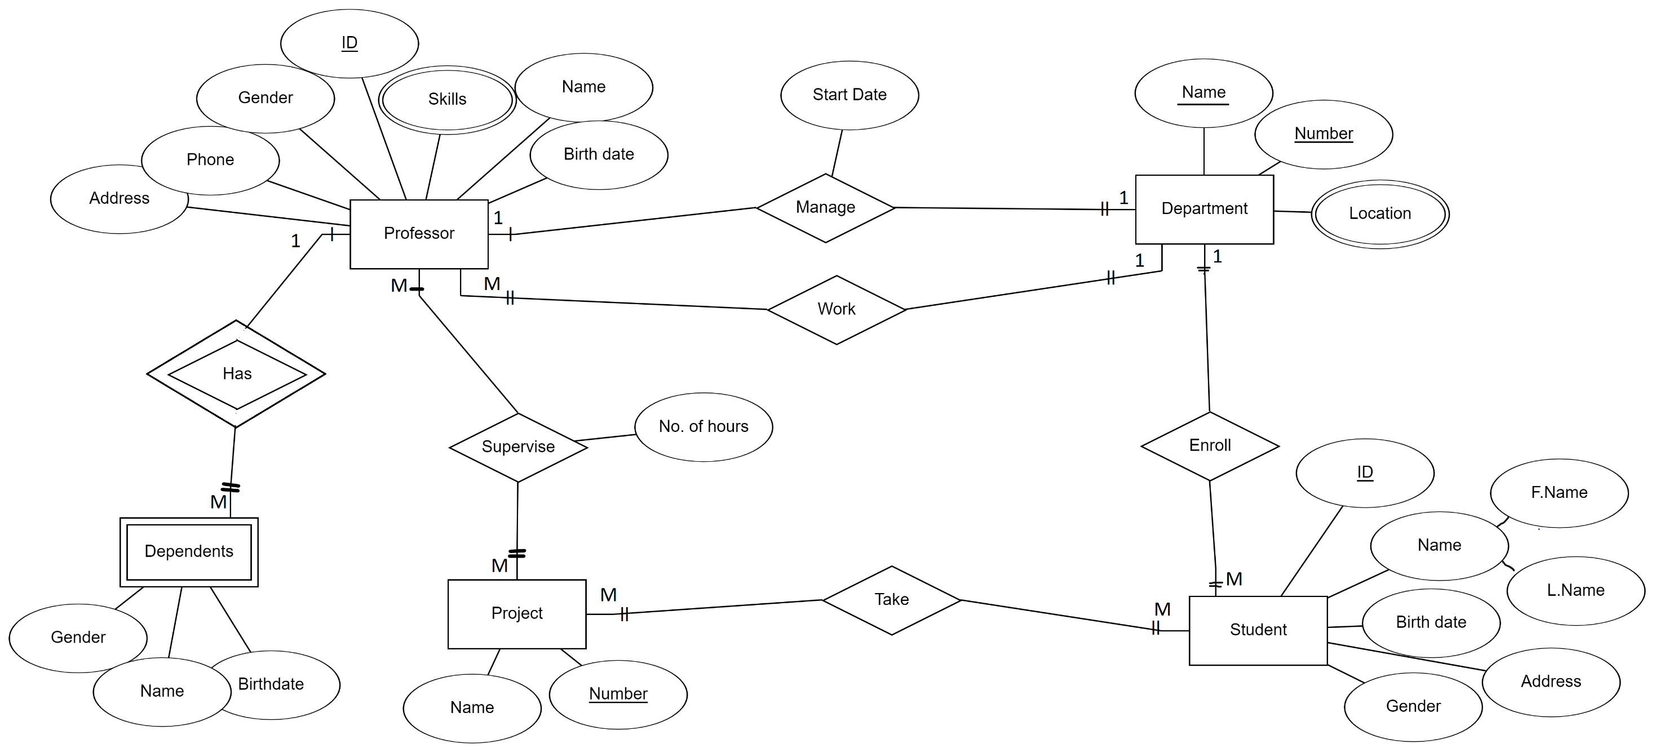

Slide 8
Company ERD Case
The company is organized into departments. Each department has a unique name, a unique Code and an employee who may manage the department. We keep track of the start date of the department manager. A department may have several locations.
Each department controls number of projects. Each project has a unique name, a unique number and is located at a Single location.
We store each employee’s social security number (SSN), address, salary, gender and birth date.
Each employee works for one department but may work on several projects.
We keep track of the number of hours per week that an employee currently works on each project.
In some case the employee may supervise other employees.
Each employee may have number of dependents. For each dependent: name, gender and birth date.

Slide 9
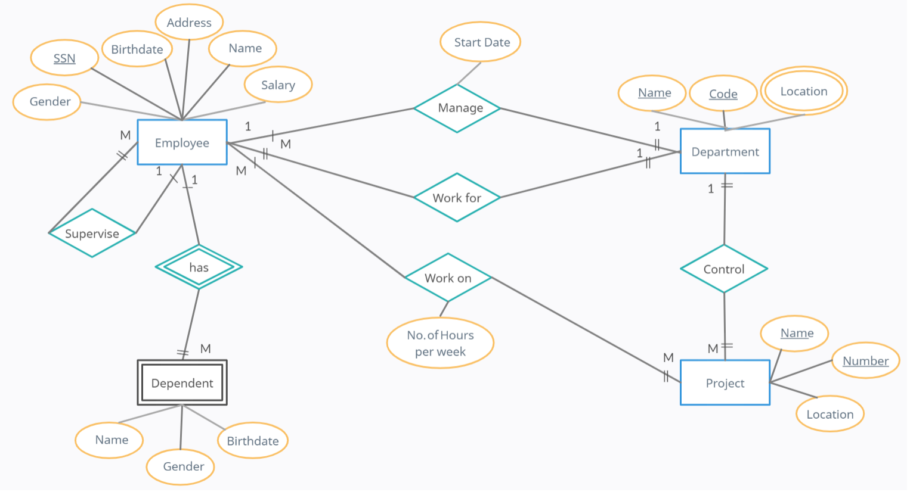
Mandatory
optional

